Slide 1
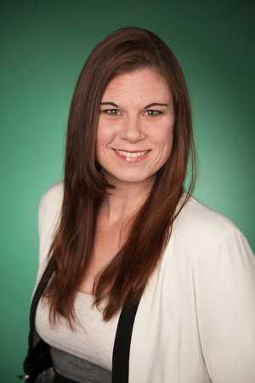
Hitting a Growth Spurt: Moving VUMC Toward Organizational Maturity Through Digitization and Standardization
Presenters
Colleen Egan is the Director of VUMC IT’s Relationship Management team, dedicated to building trusted relationships with VUMC stakeholders through transparency, expert communication, and issue resolution. Colleen has worked in IT operations for over 16 years with a consistent focus on maximizing the user experience through effective technology. Most recently, Colleen led the intensive effort to equip the VUMC workforce with remote working capabilities, as well as facilitated multiple workgroups to bring innovative and collaborative technologies to the bedside during the COVID-19 epidemic. In her spare time, Colleen enjoys making greeting cards, cooking for friends and family, and spending time on the lake.
Colleen Egan

Slide 2
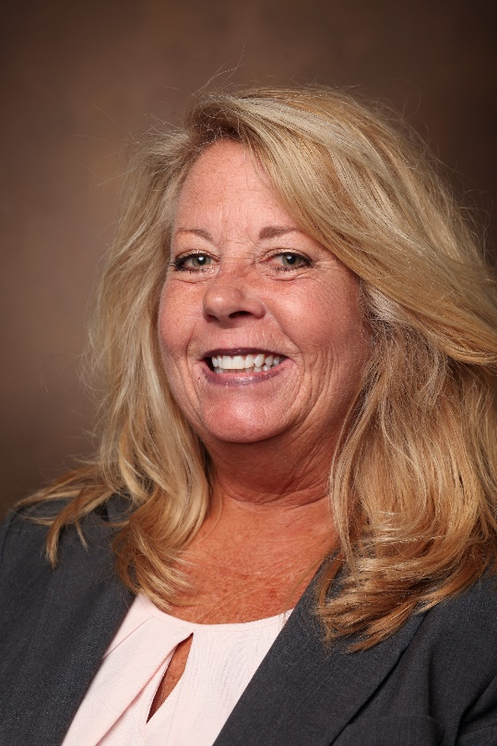
Hitting a Growth Spurt: Moving VUMC Toward Organizational Maturity Through Digitization and Standardization
Presenters
Jennifer Keen is the Director of Project Management for Vanderbilt University Medical Center Information Technology. Jennifer is a graduate of Austin Peay State University, a Project Management Professional (PMP), and certified in ITIL. Jennifer’s IT career started at the University of Tennessee where she taught software to faculty and staff. In her thirty years at VUMC, she has been a Business Analyst in telephony and networking. She has provided second and third tier computing support to technical admins throughout the institution. She has led multiple teams of Service Delivery Managers, Graphic Content and Web-site Administrators, along with Project Managers. She currently leads a team of 17 project managers. The project portfolio consists of 180 – 200 simultaneous projects in all areas of IT including development, networking, audit and compliance, end-user-devices, service management, data centers, telephony, hosting services, and business operations. While not working, Jennifer enjoys gardening and reading. She has one daughter that is a Senior Design Lead for an international logistics/supply chain consulting and solutioning company.
Jennifer Keen

Slide 3
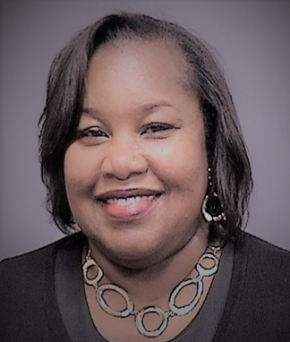
Hitting a Growth Spurt: Moving VUMC Toward Organizational Maturity Through Digitization and Standardization
Presenters
Cynthia Allen is a Principal IT Project Manager for Vanderbilt University Medical Center. Cynthia is a graduate of Middle Tennessee State University, a Project Management Professional (PMP), Certified Scrum Master (CSM) and International Software Testing Qualifications Board Certified (ITSQB). During her nearly six years at Vanderbilt, she has led technology enhancing projects with innovative approaches and successful outcomes. Driven by her commitment to Training and Development, Cynthia is a Preceptor for a Nursing Informatics Practicum student and a mentor to Project Managers in the organization who are interested in developing or improving their project management skills. Cynthia loves entertaining and events planning and is a member of the Activities Committee where she plans team building activities for the IT department. When Cynthia isn’t leading Innovative Technology Projects for Vanderbilt University Medical Center, she is courtside at her son’s basketball games and is the loudest and proudest mom in the stands.
Cynthia Allen

Slide 4
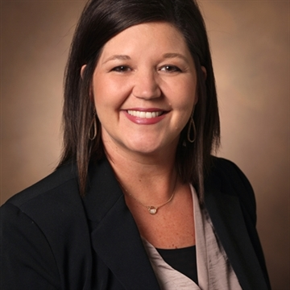
Hitting a Growth Spurt: Moving VUMC Toward Organizational Maturity Through Digitization and Standardization
Presenters
Erin Moorman is a Senior Customer Care Specialist in Health IT on the Customer Services Team, and we partner with clinicians, surgery schedulers, & front desk staff across the adult enterprise to ensure effective and efficient use of Health IT tools. We assist in identifying and facilitating possible enhancements to the system to make "the day in the life of..." simpler for our end users. Erin has worked in Health IT for 5+ years and at Vanderbilt for 9 years. Prior to her role as a Customer Care Specialist, Erin was an Asst Director in our Access Center where she led multiple teams to a centralized call center approach, working closely with several specialties/clinics to best serve our patients for their scheduling needs. In Erin's spare time, she enjoys watching her son play high school football and baseball and visiting her daughter in Knoxville as she attends UTK. She also enjoys reading, and spending time with family and friends.
Erin Moorman

